Slide 1
Academic Performance and Civic Engagement
Fall 2019 Business Analytics
Michele Lan, Serfine Okeyo, Andrea Niu

Slide 2
Notes from class on presentation
Most important
Put this up front / hook within 1st 30 seconds
Put background later — need some context for why this is important
Why should people listen to you
Then support with sources, metrics, graphs, visualizations
Tell us a little bit about why you chose to do certain data transformations/processing
Think about what you want people to get from the data; highlight the specific things to focus on
Make sure to add a call-to-action about the business answer
Consider what your perspective is and who you are talking to
Can make specific bars a different color to highlight peaks, or add data labels

Slide 3

Business Question
How can we improve young adult civic engagement through the education system?
Why care? 2016, 2020 elections
Need: Higher voter turnout!
How? Education System
Who? Legislators and teachers (board of education)
Metrics? Voter turnout
Notes:
Need
Upcoming elections, midterm elections and presidential election in 2020, we want young voters to feel empowered, turn up to elections, and use their right to vote
Questions of our democracy being compromised
Who
Legislators can help us improve education from the higher up level, implement laws mandating certain programs, civic engagement programs
Teachers! Direct contact with students, allowing them to speak up, open ended conversation, and maybe engage them with election,
Hook: What do you remember when you think of the 2016 election results? Regardless of which side etc etc.Were you surprised / what kind of emotions did you feel? For many, shock was the predominant emotion they felt in the wake of Trump’s election. Many had expected that Clinton would inevitably win, but poor voter turnout in key states may have helped Trump win the election. Consequently, we are interested in investigating the factors that influence voter turnout.

Slide 4
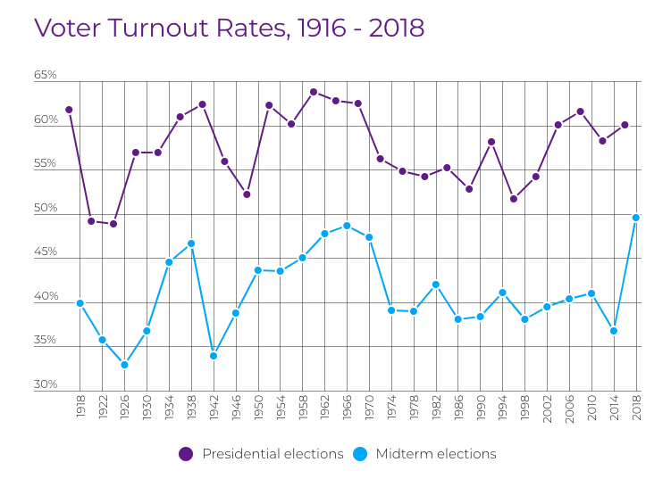
Source: https://www.fairvote.org/voter_turnout#voter_turnout_101
Notes:
Metrics
Where are we at right now? And what’s our benchmark for improving?
In 2016, voter turnout was 49.6% for midterm elections, 60.9% for the presidential. For young people 18-24 in midterm elections in 2018, the turnout was 35.8%.
Almost 92 million eligible Americans did not vote in the 2016 presidential elections
Young people are considered the most important and influential people in elections. How can we get them to vote?

Slide 5
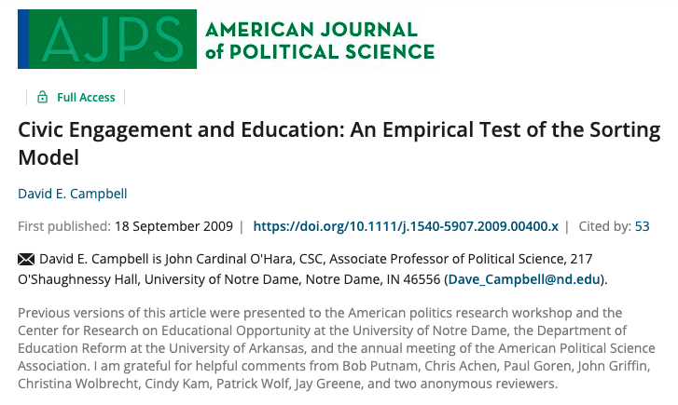
Notes:
What people have done previously-

Slide 6
“There is a broad consensus...that education is positively correlated with a range of civic and pro-social behaviours” (Putnam, 2000).
“…A host of studies find that education is positively associated with voter turnout (Campbell,Converse, Stokes and Miller, 1960; Verba, Schlozman, and Brady 1995; Rosenstone and Hansen 1993).”
Source: Schooling and Voter Turnout (Chevalier, Doyle), Institute for the Study of Labor
Notes:
What is the current state of voter turnout and education in Baltimore? Does this hold true for high school students in baltimore?

Slide 7
Data Questions
Which education system metrics should we target to increase voter turnout?
Which Baltimore County areas should we prioritize our efforts towards?

Slide 8
Data Analysis Summary
Multivariable Regression
Linear Regression (with Plots, R-Squared)
Correlation
significant variables
Cluster Analysis
Notes:
From multivariable regressions:
Significant factors influencing voter turnout include High School Chronic Absence Rate and High School Dropout/Withdrawal Rates
Correlations
Negative correlation between voter turnout and HS absence and dropout, and slight positive between HS completion and turnout

Slide 9
Data Analysis Summary
Dataset 2010 Baltimore County Data for Voter Turnout* 2010-13 Schooling Metrics by Core Service Area
Independent Variables Observed:
High School Suspensions/Expulsion Rates (2010)
High School Chronic Absence Rates (2010)
High School Dropout/Withdrawal Rates (2010)
High School Completion Rates (2010)
% of high school students that passed US. Government Class (2010)
*excludes Baltimore City
Notes:
From multivariable regressions:
Significant factors influencing voter turnout include High School Chronic Absence Rate and High School Dropout/Withdrawal Rates
Correlations
Negative correlation between voter turnout and HS absence and dropout, and slight positive between HS completion and turnout

Slide 10
Data Analysis Summary
Dataset 2010 Baltimore County Data for Voter Turnout* 2010-13 Schooling Metrics by Core Service Area
Independent Variables Observed:
High School Suspensions/Expulsion Rates (2010)
High School Chronic Absence Rates (2010)
High School Dropout/Withdrawal Rates (2010)
High School Completion Rates (2010)
% of high school students that passed US. Government Class (2010)
*excludes Baltimore City
R-squared: 62%
P-value: 4.3E-5
P-value: 0.02
Notes:
From multivariable regressions:
Significant factors influencing voter turnout include High School Chronic Absence Rate and High School Dropout/Withdrawal Rates
Correlations
Negative correlation between voter turnout and HS absence and dropout, and slight positive between HS completion and turnout

Slide 11
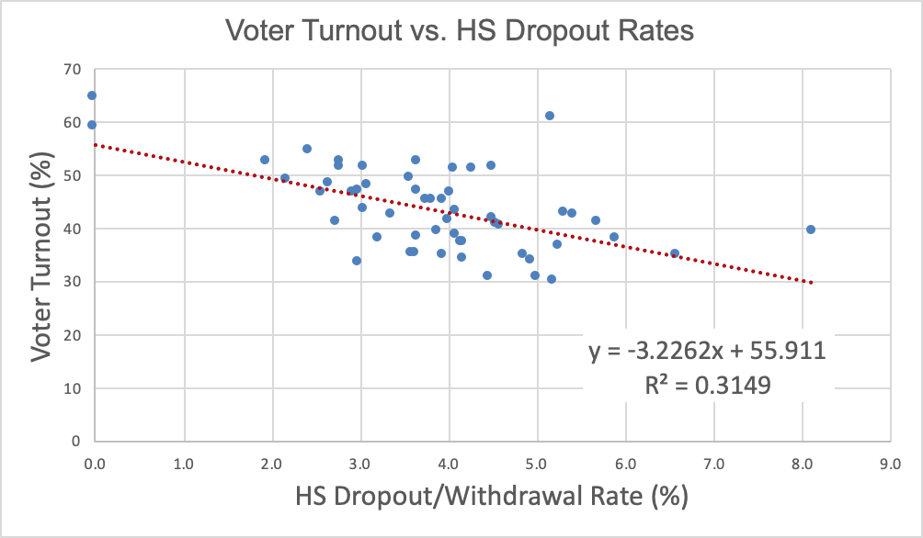

Slide 12

10% increase in HS dropouts...
32% decrease in voter turnout
Notes:
“Each 10% increase in HS dropouts is correlated with a 16% decrease in voter turnout”
“Each 10% increase in chronic absenteeism is correlated with a 5% decrease in voter turnout”

Slide 13
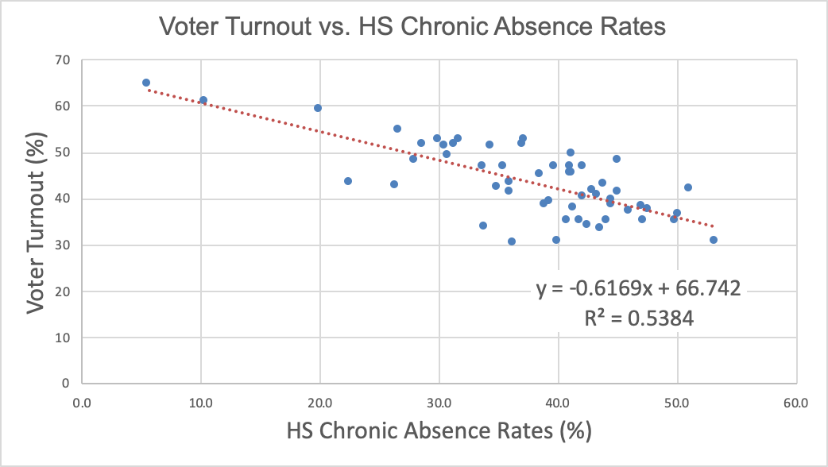
(Chart 2)

Slide 14
10% increase in chronic absences...
6% decrease in voter turnout
Notes:
“Each 10% increase in HS dropouts is correlated with a 16% decrease in voter turnout”
“Each 10% increase in chronic absenteeism is correlated with a 5% decrease in voter turnout”

Slide 15
Data Conclusion 1
“Which education system metrics should we target to increase voter turnout?”
Chronic absence and dropping out are significant predictors of lower voter turnout.
Notes:
Chronic absence is also correlated with dropout rates. Chronic absences -> dropping out -> lower civic engagement
“By high school, irregular attendance is a better predictor of school dropout than test scores. A study of public school students in Utah found that a student who is chronically absent in even a single school year between the eighth and twelfth grades is over seven times more likely to drop out of school than a student who is not chronically absent.10”

Slide 16

Business Answer 1
We should focus on reducing rates of chronic absenteeism and dropping out to boost voter turnout.
Possible explanations
Positive environment/reinforcement
Student government elections
Exposure to current events and civic engagement
Environment to question/discuss beliefs
Notes:
Just being in school, sitting in class and being surrounded by people teaching and people learning, you may feel more influenced to vote!
Possible factors? Positive environment, positive reinforcement, student government elections, getting to know current events, experiencing an environment where you learn to question and speak up about your beliefs

Slide 17
Cluster Analysis Results
Patterson Park N, E
Howard Park /
W Arlington
Mt. Washington / Cold Spring
Lowest Voter Turnout Highest Absence
Average Voter Turnout Average Absence
Highest Voter Turnout
Lowest Absence Rates

Slide 18
Cluster Analysis Results
Distribution of Metrics for Cluster Anchors
Absence Rates
Voter Turnout
Dropout Rates
Patterson Park
Howard Park
Mt Washington

Slide 19
Data Conclusion 2
“Which Baltimore County areas should we prioritize our efforts towards?”
Areas similar to Patterson Park, N E are part of a cluster of CSAs with the highest chronic absence and dropout rates and lowest voter turnouts.
Notes:
Chronic absence is also correlated with dropout rates. Chronic absences -> dropping out -> lower civic engagement
“By high school, irregular attendance is a better predictor of school dropout than test scores. A study of public school students in Utah found that a student who is chronically absent in even a single school year between the eighth and twelfth grades is over seven times more likely to drop out of school than a student who is not chronically absent.10”

Slide 20
Business Answer 2
Areas with high absences and low voter turnout similar to Patterson Park, N & E, should be prioritized
Possible explanations
CSAs with high dropout or chronic absence rates may result in students missing key explanations on why civic engagement is important.
Systemic inequities in these CSAs (socioeconomic / demographic) may be responsible for both high absence and dropout rates and low voter participation
Notes:
Just being in school, sitting in class and being surrounded by people teaching and people learning, you may feel more influenced to vote!
Possible factors? Positive environment, positive reinforcement, student government elections, getting to know current events, experiencing an environment where you learn to question and speak up about your beliefs

Slide 21
Recommendations for Action
What actions can schools and CSAs take?
Track attendance to identify students at risk of becoming chronically absent
Set milestones towards graduation to discourage dropping out
For high priority CSAs, investigate factors resulting in high dropout or chronic absence rates
Timeframe: 2020 and 2024 elections
Notes:
Methods to combat chronic absenteeism: https://www2.ed.gov/about/inits/ed/chronicabsenteeism/toolkit.pdf
Who are we talking to/writing to? Teachers, legislators
Call to action: help kids stay in school!

Slide 22
Future Steps
Obtain more recent datasets and perform analysis on year-over-year trends to see if the pattern is consistent
Seek more complete datasets (including Baltimore City)
Examine relationship with voter registration
Examine demographic and socioeconomic factors characteristic of the high priority CSAs
Try different numbers of clusters

